Slide 1
Web Application Development ISCG7420 Introduction to Web Development
School of Computing, Electrical and Applied Technology

Slide 2
Outlines – Django Rest-Framework
Token Authentication
Permission
Registration
permissions.py

Slide 3
Django Authentication
https://www.django-rest-framework.org/api-guide/authentication/
BasicAuthentication
TokenAuthentication

Slide 4
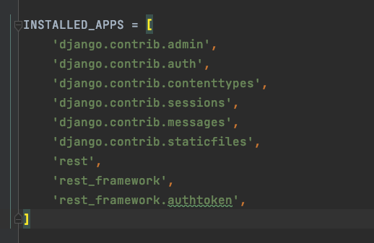
Token Authentication

Slide 5
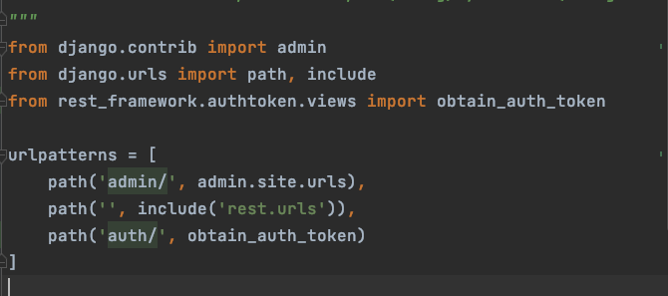
Routing
In urls.py (project level)

Slide 6
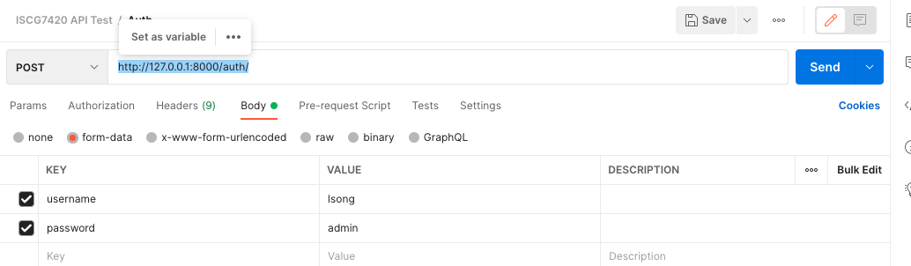
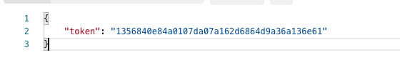
Create Taken table
makemigration
migrate
Sent a post request from Postman

Slide 7
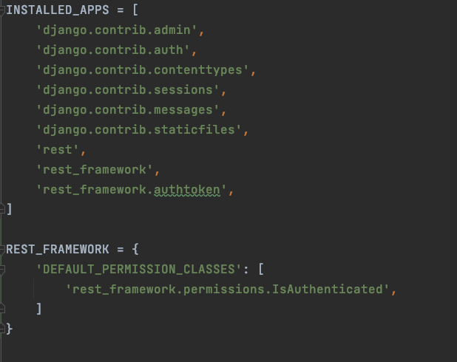
Permission
https://www.django-rest-framework.org/api-guide/permissions/
Add “DEFAULT_PERMISSION_CLASSES” IsAuthenticated to settings

Slide 8
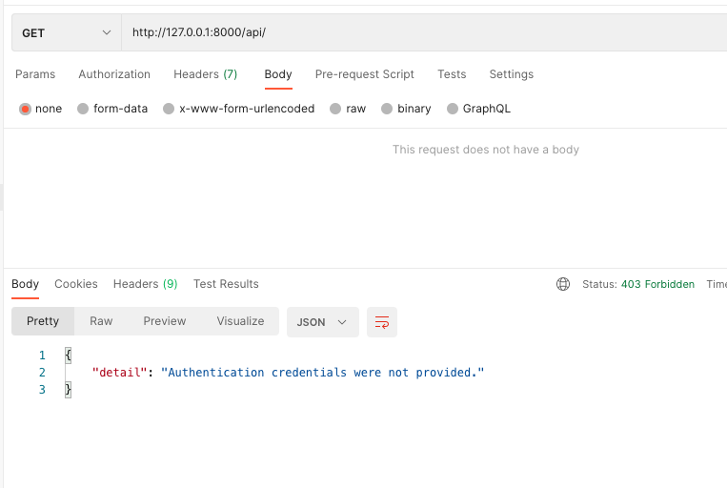
Test the DEFAULT_PERMISSION_CLASSES

Slide 9
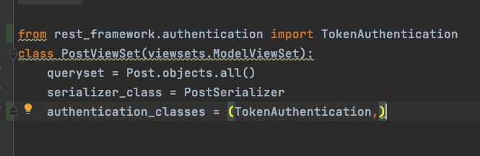
In your viewset

Slide 10
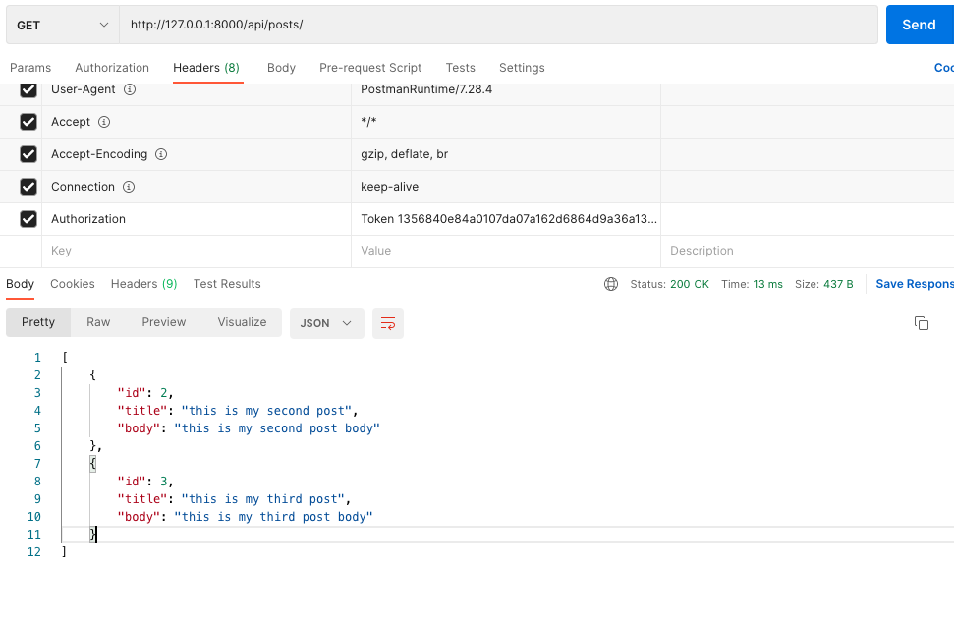
Test your token

Slide 11
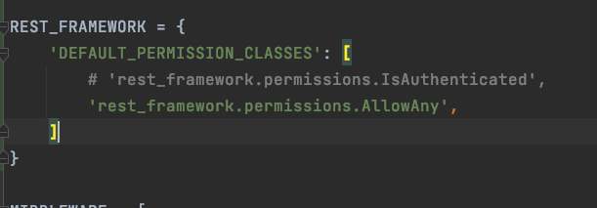
Try AllowAny

Slide 12
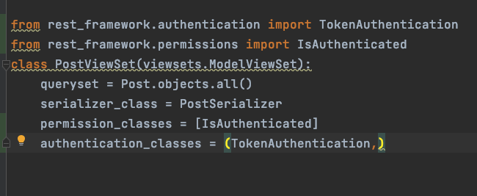
Permissions Class
Remove ’Default_Permission_class’ from setting file
In your viewset

Slide 13
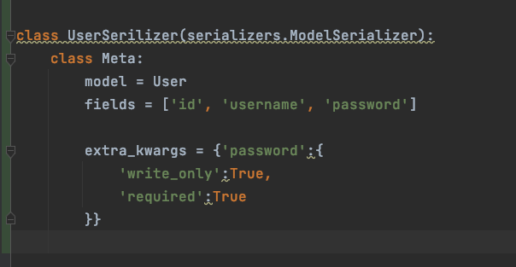
In serializer

Slide 14
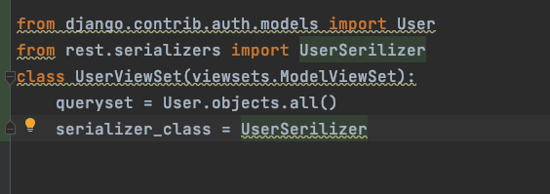
ViewSet

Slide 15
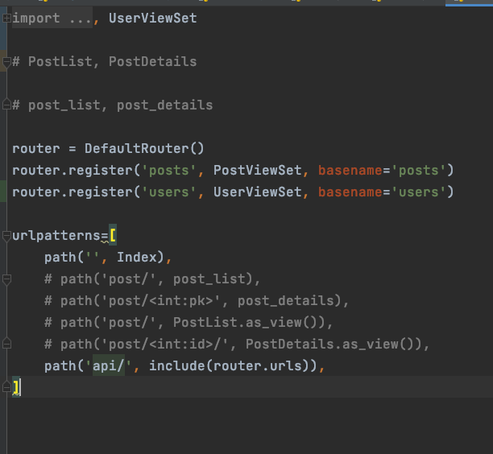
Register users to urls in app level

Slide 16
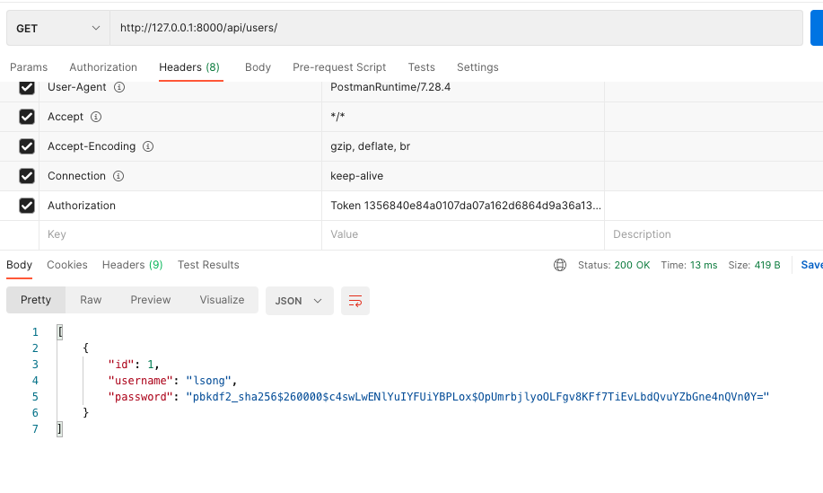
Test in Postman

Slide 17
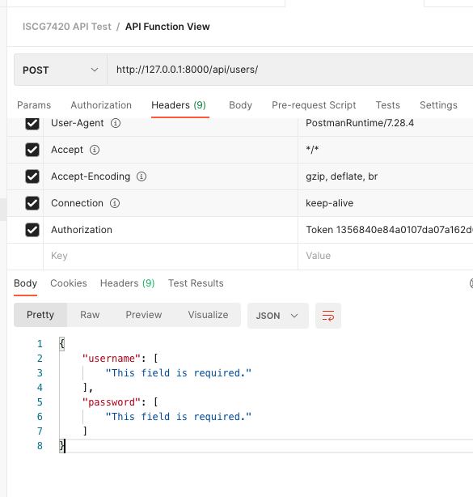
Test Post Request

Slide 18
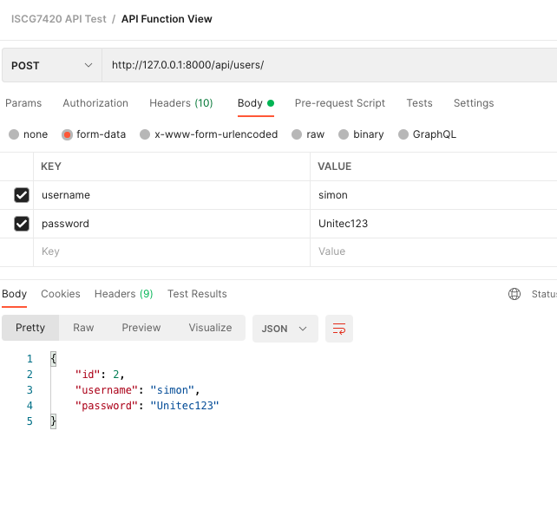
Post with username and password

Slide 19
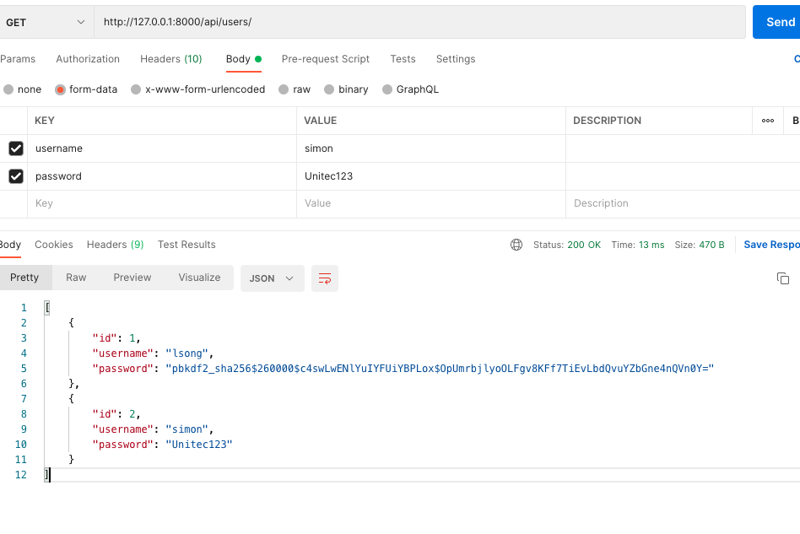
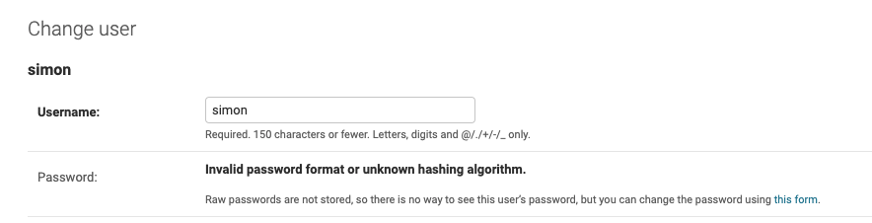
Problems

Slide 20
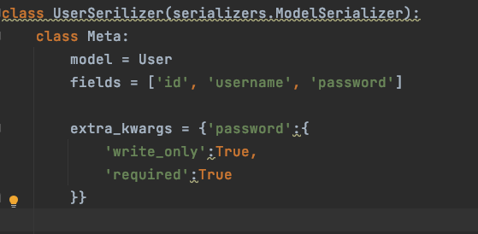
Make password write only

Slide 21
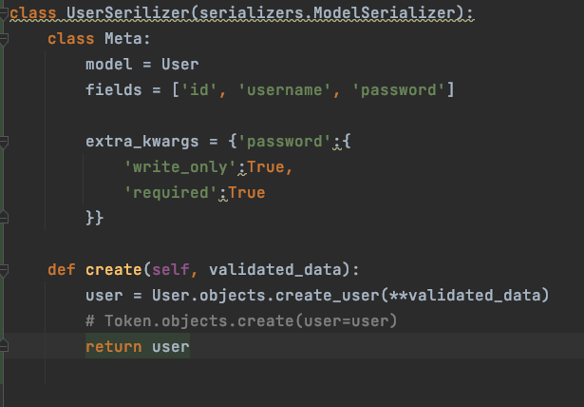
Overwrite create method

Slide 22
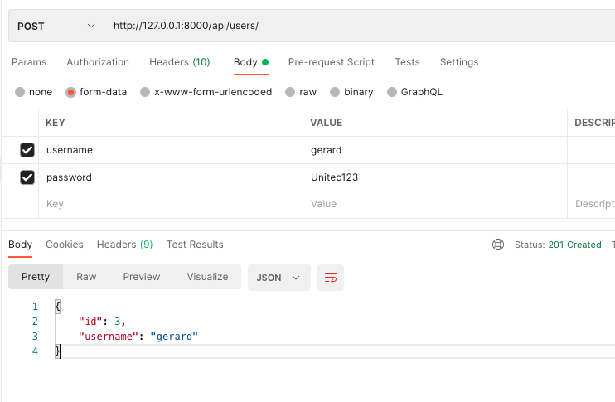
Test new registration

Slide 23
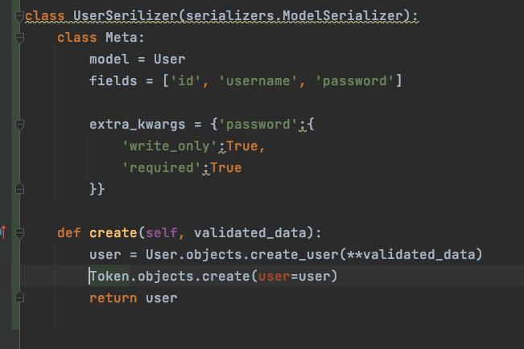
Create Token for signup user
from rest_framework.authtoken.views import Token

Slide 24
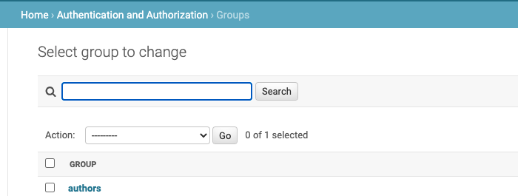
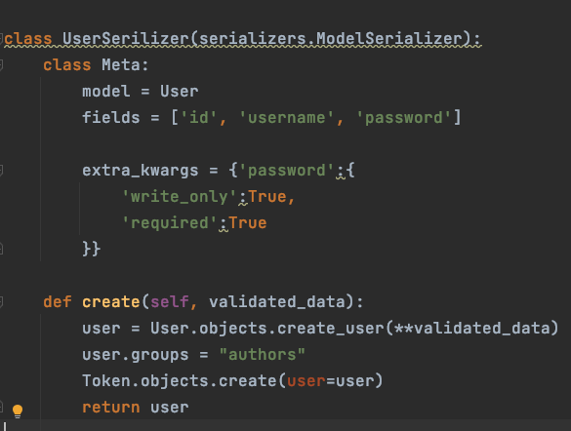
Create user group

Slide 25
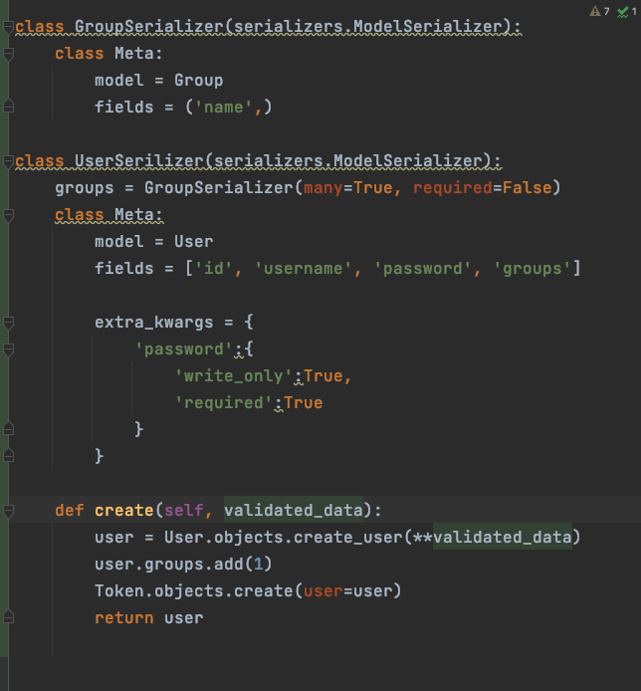
Show groups to return data

Slide 26
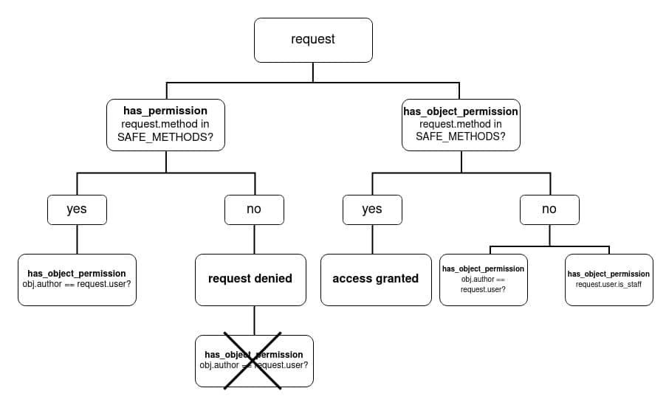
has_permission VS has_object_permission

Slide 27
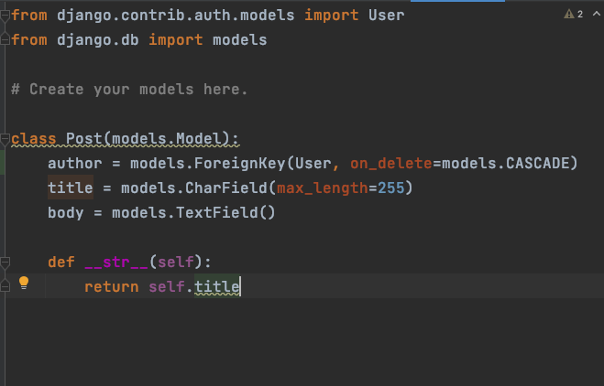
Add author to Post Model

Slide 28
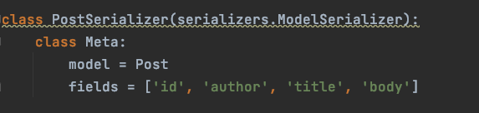
Edit serializers

Slide 29
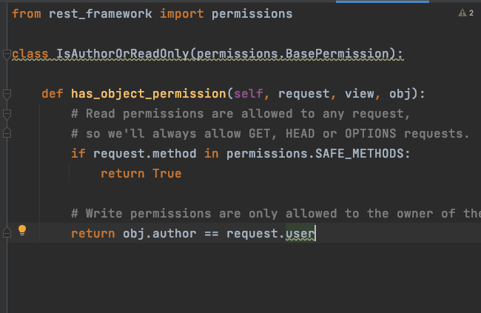
permissions.py

Slide 30
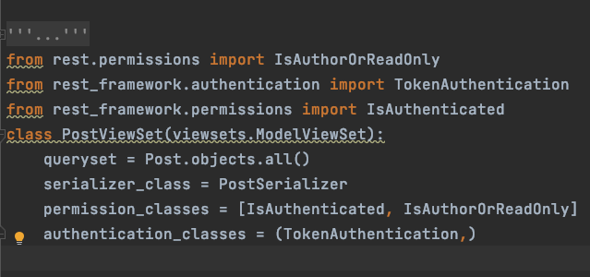
Add the permission to permission_classes

Slide 31
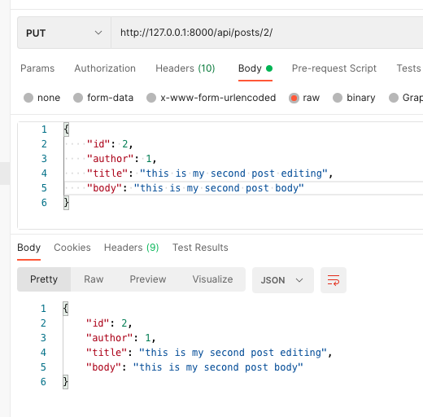
Test in postman (with correct login)

Slide 32
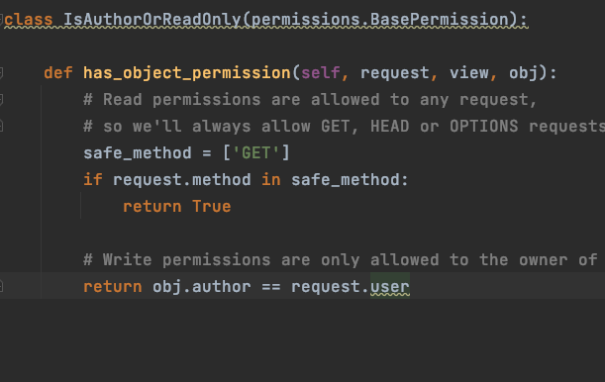
Write your own safe method

Slide 33
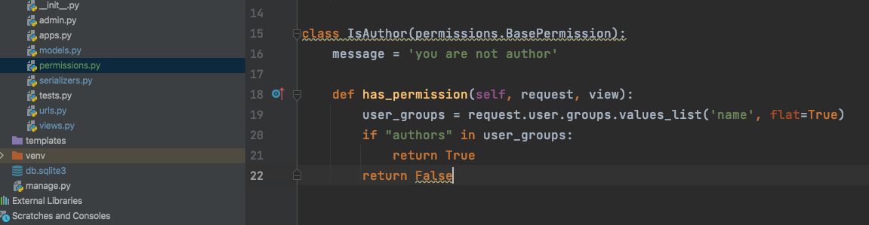
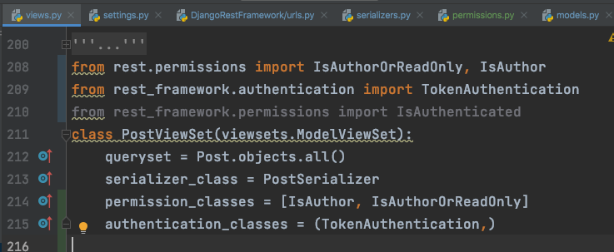
Group permission

Slide 34
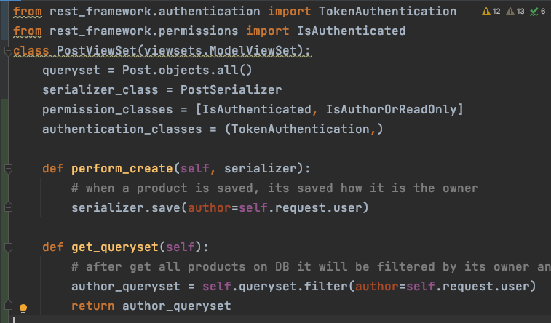
More options in Model ViewSet
https://www.django-rest-framework.org/api-guide/generic-views/

Slide 35
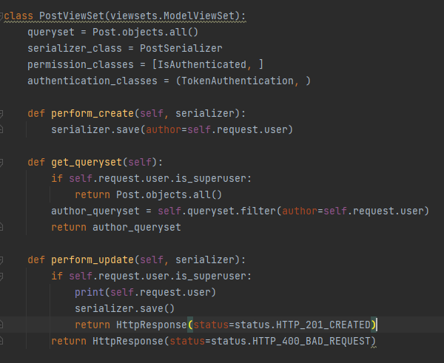
Set permission to each methods

